Slide 1
Gregory Toscano, Eric Fortes, David Shabo

Slide 2
Contents
What is LinkedIn?
Why LinkedIn?
OAuth 2.0
LinkedIn API
Rest API
Storage
Project Voldemort
Hadoop
Search Infrastructure
Zoie
Bobo

Slide 3

What is LinkedIn Used For?
LinkedIn is a business-Oriented Social Networking Service. It is mainly used for professional Networking.
Unlimited Networking
A Global Think Tank
A Recruitment Tool

Slide 4
LinkedIn Information
Founded In December 2002 and Launched on May, 2003
LinkedIn is ranked #13 Globally and #9 in the U.S.
Joined the NYSE May 19th, 2011 with an initial offering of $45 a share. Today it is around $263

Slide 5
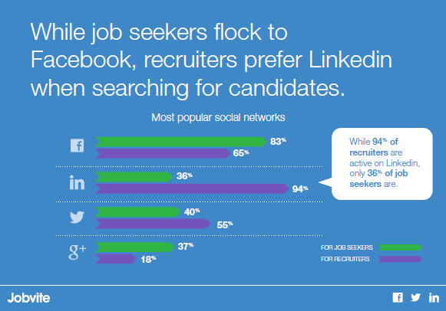
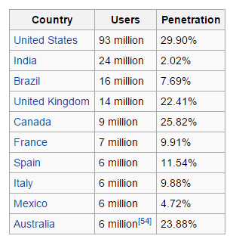
Why LinkedIn?
Alexa

Slide 6
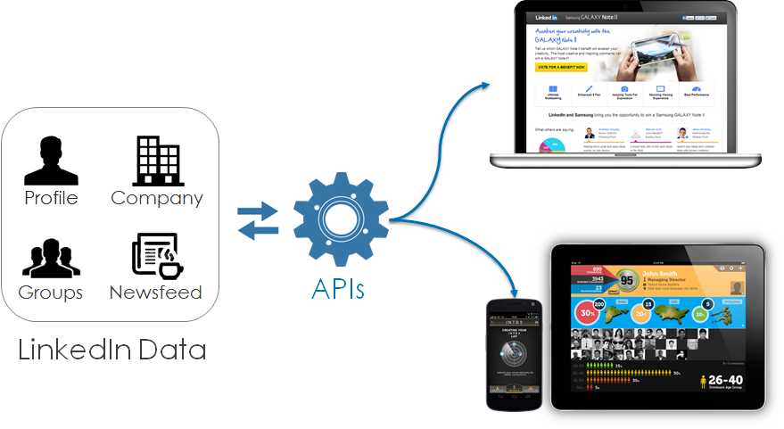
LinkedIn APIs..what are they?
Rest API
Sign In With LinkedIn
Apply with LinkedIn
Share With LinkedIn
JavaScript SDK
Mobile SDK

Slide 7
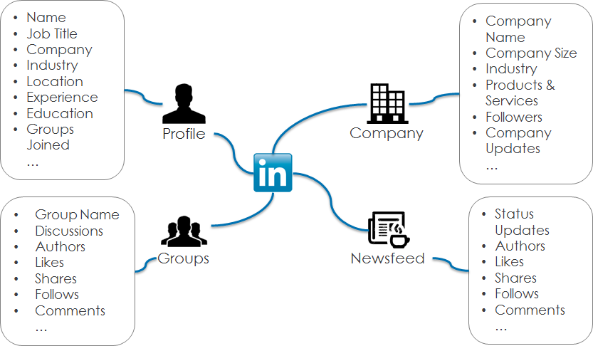

Slide 8
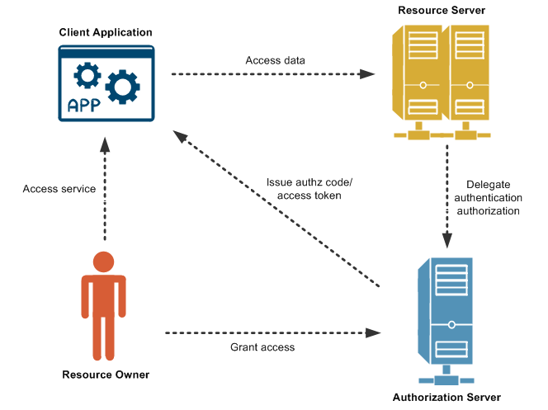
OAuth 2.0
Configuring your LinkedIn application
Request an Authorization Code
Exchange Authorization Code for a Request Token
Make authenticated requests
Refresh your Access Tokens
Notes:
Additionally, there are several 3rd party libraries available in the open source community that abstract the OAuth 2.0 authentication process for you in every major programming language.

Slide 9
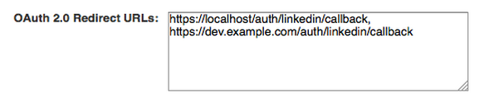
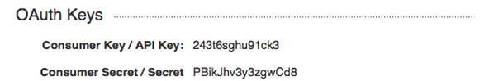
Configuring your LinkedIn application

Slide 10
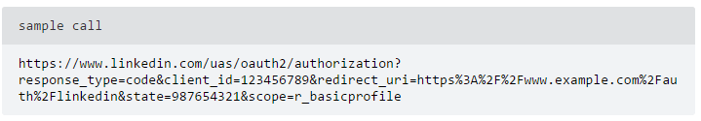
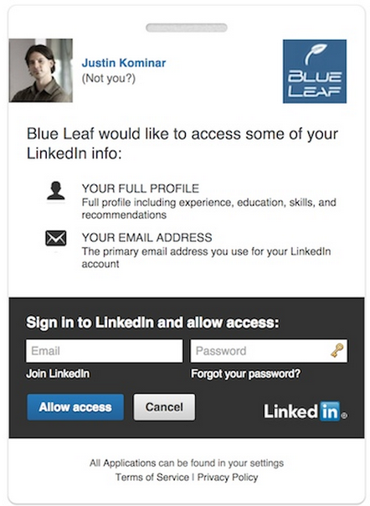
Request an Authorization Code

Slide 11
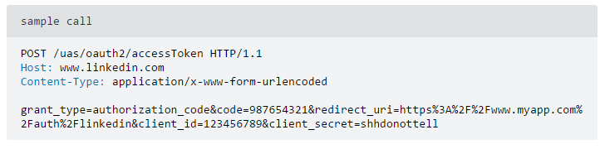
Exchange Authorization Code for a Request Token

Slide 12
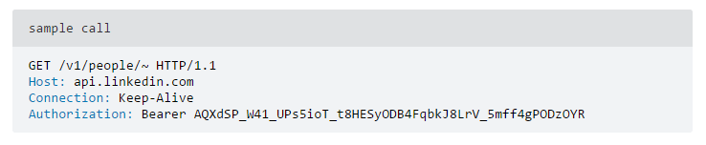
Make authenticated requests

Slide 13
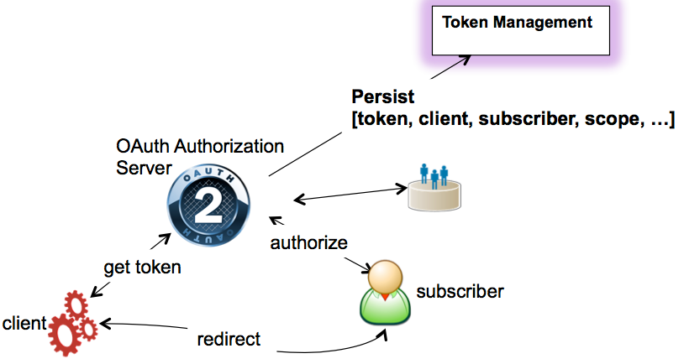
Refresh your Access Tokens

Slide 14
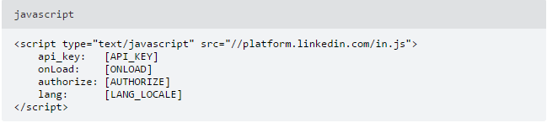
Javascript SDK
api_key: LinkedIn applications API Key (required)
onLoad: comma-separated list of the names of Javascript functions that you want the SDK to execute once it has loaded itself.
authorize: default value is false, which requires user to login on every page load. When set to true, will search for a cookie containing existing user authentication and if it finds it you will be logged in. If not found, you will be asked to login.
lang: language code for the UI of the SDK output. Default is US English [en_us].
.

Slide 15


Javascript SDK continued...
URL to include within the script tag is “//platform.linkedin.com/in.js”.
in.js is the Javascript file containing all the information to use.
IN
The global IN object, the namespace of the LinkedIn JavaScript SDK.
Logout Example
Handling Events Example

Slide 16
Mobile SDK
Brief Overview
The SDK provides:
Single sign-on (SSO) authentication, in conjunction with the LinkedIn mobile app.
A convenient wrapper for making authenticated calls to LinkedIn’s REST API’s
“Deep linking” to additional member data in the LinkedIn mobile app
Sample application that demonstrate best-practice implementations of all the SDK’s features.
Mobile SDK

Slide 17
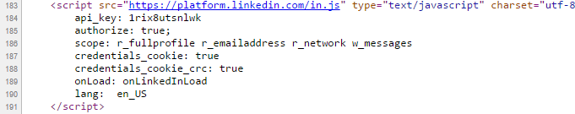
Networking
Socilab. Network analytics
Socilab Tool
LinkedIn Javascript SDK

Slide 18
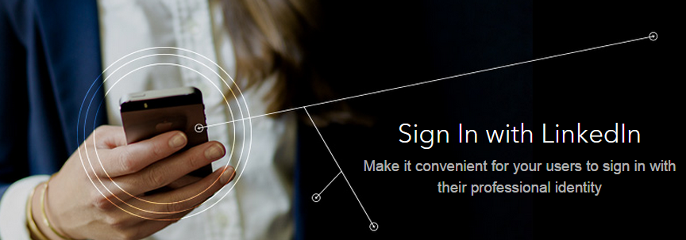
REST API - Sign in With LinkedIn
Notes:
Use Sign in with LinkedIn to:
Reduce friction and get more sign-ups by allowing users to sign in with LinkedIn instead of creating a new account
Minimize the cost and time associated with implementing your own login, profile management, password change and recovery workflows
Personalize your sites and apps with up-to-date member profile data
Step 2 - Retrieve basic profile data
Once you have obtained a valid access token for the user, you can use the following REST API call to retrieve basic profile data for the user:

Slide 19
SAMPLE RESPONSE FROM REST API
{ "firstName": "Frodo", "headline": "2nd Generation Adventurer", "id": "1R2RtA", "lastName": "Baggins", "siteStandardProfileRequest": { "url": "https://www.linkedin.com/profile/view?id=…" } }

Slide 20
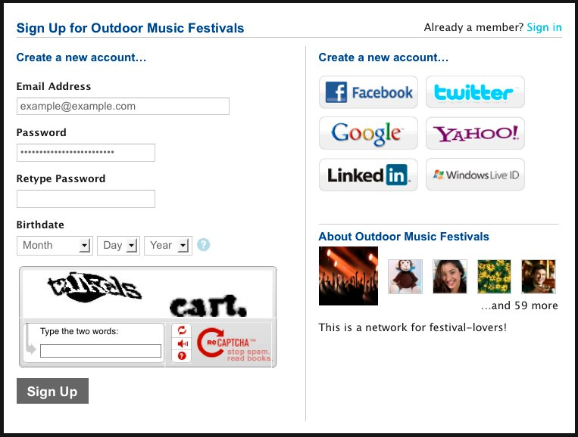

Slide 21

REST API - Apply with LinkedIn
Notes:
LinkedIn profiles can give you valuable information that you can’t always get from a resume, so you can make the best hiring decisions. Plus, applicants will appreciate a simple way to apply using their professional profile.
Use Apply with LinkedIn to:
Round out your knowledge about a candidate’s background, their recommendations, interests and who’s in their network
Incorporate a candidate’s full profile data in your careers site
Make it easy for qualified candidates to apply to your company’s jobs

Slide 22
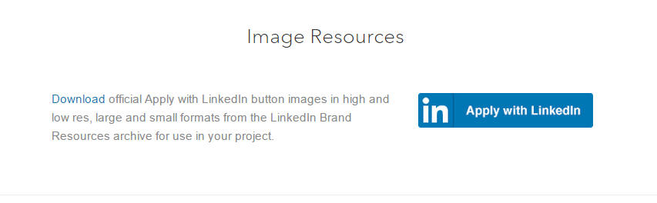
REST API - Apply with LinkedIn
Sample API Response
https://developer.linkedin.com/docs/apply-with-linkedin
Apply with LinkedIN Exampe: https://wpjobmanager.com/add-ons/apply-with-linkedin/
Notes:
Step 2 - Retrieve profile data
Once you have obtained a valid access token for the user, you can use the following REST API call to retrieve whichever fields you require from the member's profile.
There is no pre-canned call you can make to return everything available about a given user. You must specifically request each member field that you want returned in the response. Refer to the complete list of all available Member Profile Fields and provide a comma-delimited list of each field identifier in place of the fields of interest placeholder in the sample API call shown here:
-->Following these basic steps, you can now enhance your company's job applications with additional high-quality professional profile information from LinkedIn.

Slide 23

Rest API - Share with LinkedIn
Notes:
LinkedIn has become a powerful content platform, with B2B marketers telling us that half of the traffic they receive from social networks comes from LinkedIn. Make sure your content reaches an audience of professionals who are looking for relevant articles and information.
Use Share on LinkedIn to:
Grow your user base and drive traffic to your website
Get your content in front of a potential audience of millions of professionals
Benefit from viral distribution as people share your content with their professional networks

Slide 24
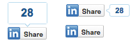
Rest API - Share with LinkedIn
Share Plugin Generator
https://developer.linkedin.com/plugins/share

Slide 25
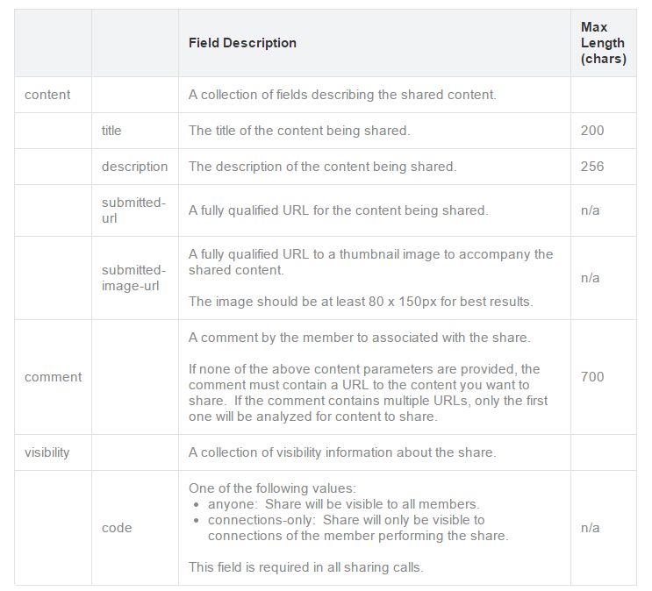

Slide 26




LinkedIn Partners
LinkedIn’s Search, Network, and Analytics Team
Project Voldemort
Search Infrastructure: Zoie, Bobo, etc
LinkedIn’s Hadoop system

Slide 27
Project Voldemort & Hadoop
Data is automatically replicated over multiple servers.
Data is automatically partitioned so each server contains only a subset of the total data
Server failure is handled transparently
Pluggable serialization is supported to allow rich keys and values including lists and tuples with named fields, as well as to integrate with common serialization frameworks like Protocol Buffers, Thrift, Avro and Java Serialization
Data items are versioned to maximize data integrity in failure scenarios without compromising availability of the system
Each node is independent of other nodes with no central point of failure or coordination
Good single node performance: you can expect 10-20k operations per second depending on the machines, the network, the disk system, and the data replication factor
Support for pluggable data placement strategies to support things like distribution across data centers that are geographically far apart.

Slide 28
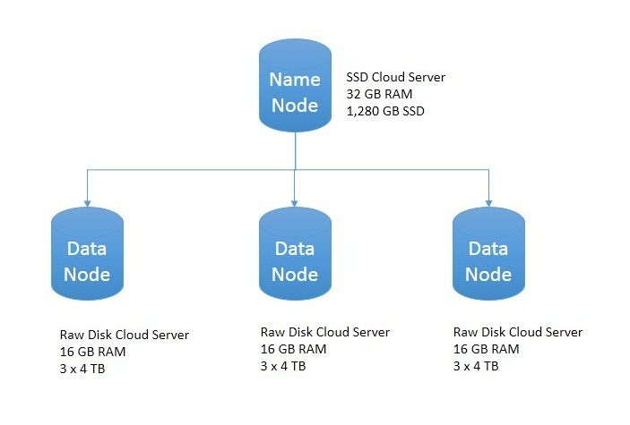
1
2
3
1
4
2

Slide 29
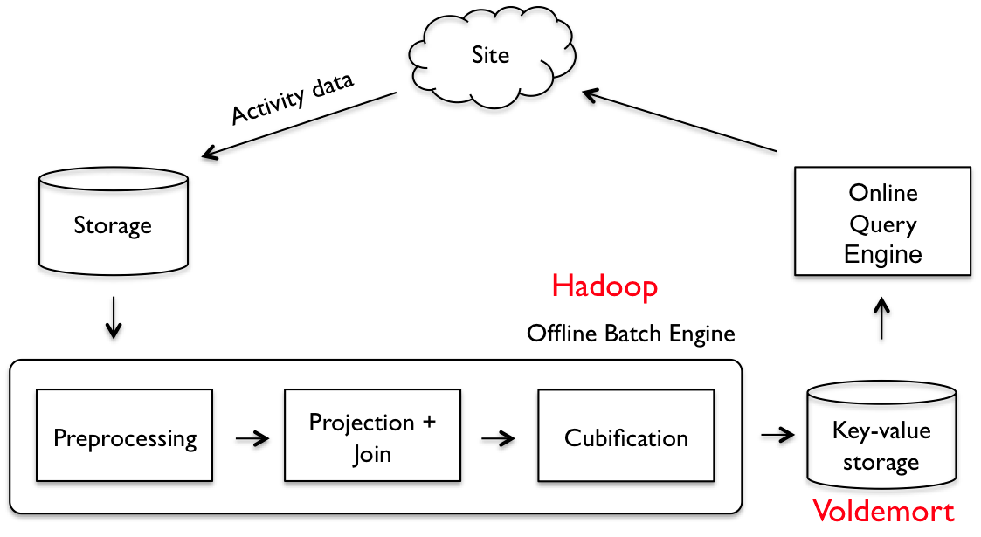

Slide 30
Search Infrastructure - Zoie
Zoie is a real-time search and indexing system built on Apache Lucene and based off the Lucene search library.
Donated by LinkedIn.com, and has been deployed in a real-time large-scale consumer website: LinkedIn.com handling millions of searches as well as millions of updates daily.
The index is persisted on disk and if there is a system crash, the index does not need to be completely rebuilt
Goals:
Additions to documents are made available to searchers immediately
Indexing must not affect search performance
Deletes or updates do not affect the search performance
Zoie Code Examples

Slide 31
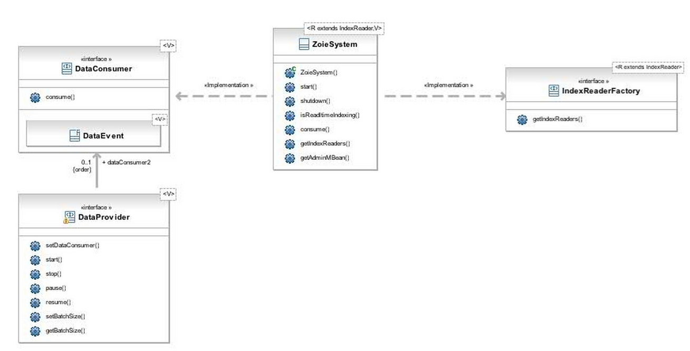
Java Class Diagram

Slide 32
Search Infrastructure - Bobo
Faceted Search Implementation written purely in Java, an extension of Apache Lucene.
While Lucene is good with unstructured data, Bobo fills in the missing piece to handle semi-structured and structured data.
Bobo Browse is an information retrieval technology that provides navigational browsing into a semi-structured dataset. Beyond the result set from queries and selections, Bobo Browse also provides the facets from this point of browsing.
Example: A LinkedIn search for “mergers”, brings up 108,345 results. But when I select people at least two connections away from me, who live in the Bay area, and are “potential employees” that narrows it down to 24 results. Since LinkedIn contains a lot of highly-structured data, it knows that “CEO” is a title and that “Cisco” is a company, so it can generate people results accordingly.

Slide 33
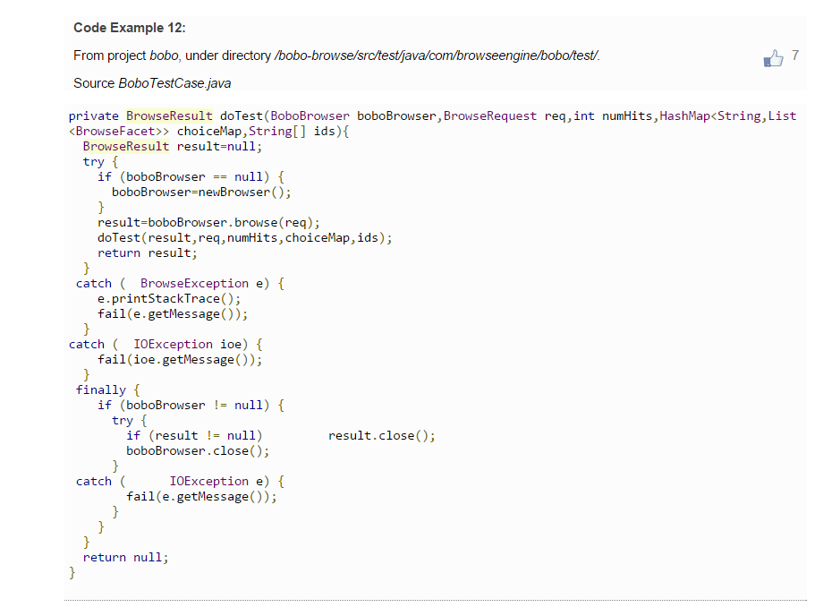
Bobo Test Case

Slide 34
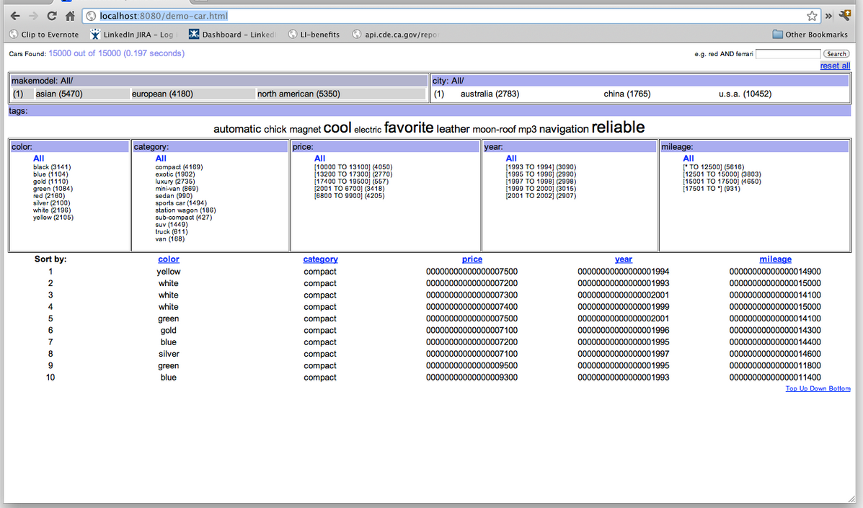
Bobo Car Example

Slide 35
How to use Zoie and Bobo together
Linking Zoie and Bobo
Bobo and Zoie are different technology libraries that compliment each other. Bobo is a query engine that handles semi-structure data, whereas Zoie is a real-time indexing engine.
Bobo + Zoie gives you the ability to do a real-time semi-structure data searching. (real-time faceting)

Slide 36
Case Studies
http://thenextweb.com/dd/2015/02/12/linkedin-takes-aim-developers-plans-lock-apis/
Highlight: From May 12, LinkedIn will limit its open APIs to just four uses:
allowing members to represent their professional identity via their LinkedIn profile using our Profile API.
enabling members to post certifications directly to their LinkedIn profile with our Add to Profile tools.
enabling members to share professional content to their LinkedIn network from across the Web leveraging our Share API.
enabling companies to share professional content to LinkedIn with our Company API

Slide 37
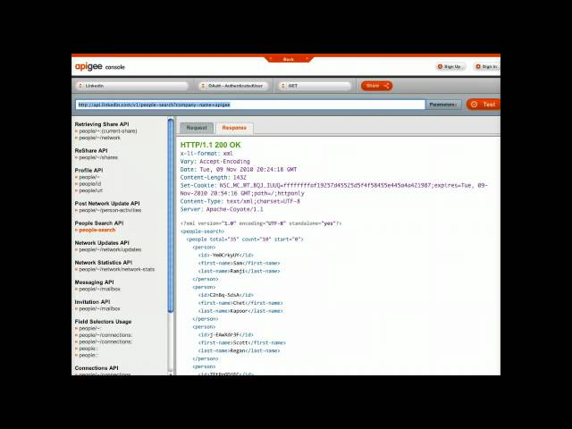

Slide 38
REST API Console
Rest Console: https://apigee.com/console/linkedin
Using Rest API Console to Find Web 2.0 Technologies (Senior Seminar Series)
Group ID: 5151077

